Slide 1
Planar Graphs

Slide 2
Planar Graphs – 平面图
A graph is called planar if it can be drawn in the plane in such a way that no two edges cross.
Example of a planar graph: The clique on 4 nodes.

Slide 3
Is K₅ planar?

Slide 4
What about K_{3,3} ?

Slide 5
Why Planar?
The problem of drawing a graph in the plane arises frequently in VLSI layout problems.

Slide 6
Regions, faces – 面
A planar representation of a graph splits the plane into regions that we call faces, including an unbounded region.
one face
two faces

Slide 7
the degree of a region deg(R)
the degree of a region, which is defined to be the number of edges on the boundary of this region.
When an edge occurs twice on the boundary (so that it is traced out twice when the boundary is traced out), it contributes two to the degree.
We denote the degree of a region R by deg(R).

Slide 8
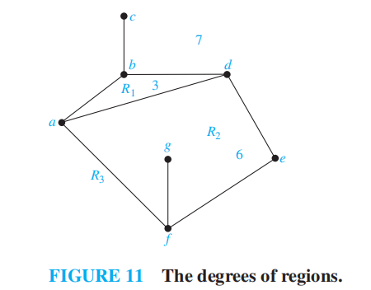
the degree of a region
Deg(R₁)=3
adba
Deg(R₂)=6
afgfeda
Deg(R₃)=7
afedbcba

Slide 9
Question
Can you redraw this graph as a planar graph so as to alter the number of its faces?

Slide 10
Example
This graph has
6 vertices
8 edges and
4 faces
vertices – edges + faces = 2

Slide 11
Example
This graph has
7 vertices
12 edges and
7 faces
vertices – edges + faces = 2

Slide 12
Euler Theorem 1752
Let G be a connected planar simple graph with e edges and v vertices. Let r be the number of regions in a planar representation of G. Then r = e − v +2.

Slide 13
Proof:
By induction on the # of cycles of G.
Base case: G has no cycles.
G is connected so it must be a tree.
Thus, e = v - 1 and r = 1.

Slide 14
Inductive step
Suppose G has at least one cycle C containing edge e.
Let
exterior
v′= # of vertices, e′ = # of edges,
r ′ = # of regions
e
interior

Slide 15
Inductive step
G′ is connected since e was on a cycle.
r ′= r-1 and G′ has fewer cycles than G.
v′= v
e′= e-1
By induction hypothesis:

Slide 16
Another Proof
Constructing a sequence of subgraphs G₁, G₂, … , G_{e} = G, successively adding an edge at each stage.
Arbitrarily pick one edge of G to obtain G₁. Obtain G_{n} from G_{n−1} by arbitrarily adding an edge that is incident with a vertex already in G_{n−1}, adding the other vertex incident with this edge if it is not already in G_{n−1}.
This construction is possible because G is connected
Let r_{n}, e_{n}, and v_{n} represent the number of regions, edges, and vertices of the planar representation of G_{n}

Slide 17

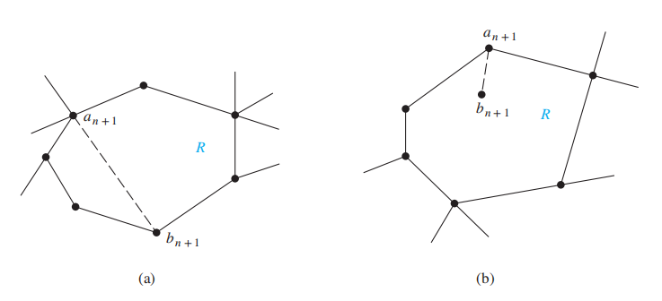
proceed by induction
r₁ = e₁ − v₁ + 2 is true for G₁
Assume that r_{k} = e_{k} − v_{k} + 2.
Let {a_{k+1}, b_{k+1}} be the edge that is added to G_{k} to obtain G_{k+1}.
There are two possibilities to consider.
r_{k+1} = r_{k} +1, e_{k+1} = e_{k} + 1, v_{k+1} = v_{k}.
r_{k+1} =e_{k+1} − v_{k+1} + 2
r_{k+1} = r_{k}, e_{k+1} =e_{k} + 1, v_{k+1} = v_{k} + 1.

Slide 18
Corollary
No matter how we redraw a planar graph it will have the same # of regions.
Proof:
r = 2 – v + e is determined by v and e, neither of which change when we redraw the graph.

Slide 19
Theorem
Every (simple) n-node planar graph G has at most 3n-6 edges.

Slide 20
Proof
n = 3: Clearly true.
n ≥ 3: consider a graph G with a maximal number of edges.
G must be connected or else we could add an edge.
Thus
n – e + r = 2

Slide 21
Proof
Every face has at least 3 edges on its boundary.
Every edge lies on the boundary of at most 2 faces.
Thus 2e>=3r

Slide 22
corollary
If G is a connected planar simple graph, then G has a vertex of degree not exceeding five.
If a connected planar simple graph has e edges and v vertices with v≥3 and no circuit of length three, then e≤2v-4

Slide 23
K₅ is not planar
A planar graph on n = 5 nodes can have at most 3n-6 = 9 edges.
Thus: K₅ is not planar.

Slide 24
K_{3,3} is not planar either
When we redraw K_{3,3} , the blue cycle will be laid out
a
x
x
a
b
y
c
z
z
y
c
b

Slide 25
The Kuratowski’s theorem
If a graph is planar, so will be any graph obtained by removing an edge {u, v} and adding a new vertex w together with edges {u, w} and {w, v}. Such an operation is called an elementary subdivision.
The graphs G₁ = (V₁, E₁) and G₂ = (V₂, E₂) are called homeomorphic if they can be obtained from the same graph by a sequence of elementary subdivisions.

Slide 26
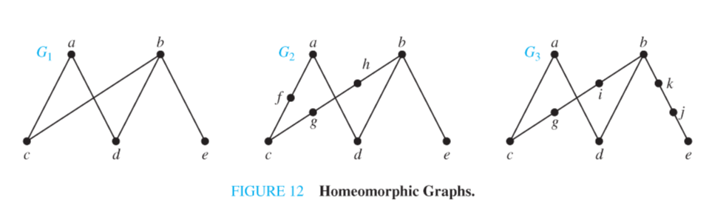
Example 7
Show that the graphs G₁, G₂, and G₃ displayed in Figure 12 are all homeomorphic.

Slide 27
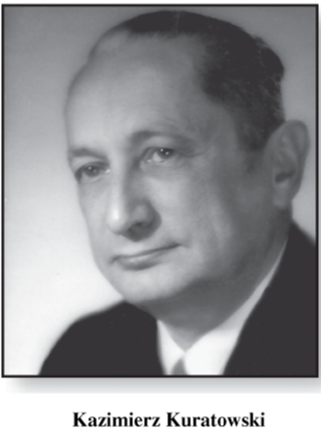
Kuratowski’s Theorem [1930]
A graph is nonplanar
if and only if
it contains a subgraph homeomorphic to K_{3,3} or K₅.

Slide 28
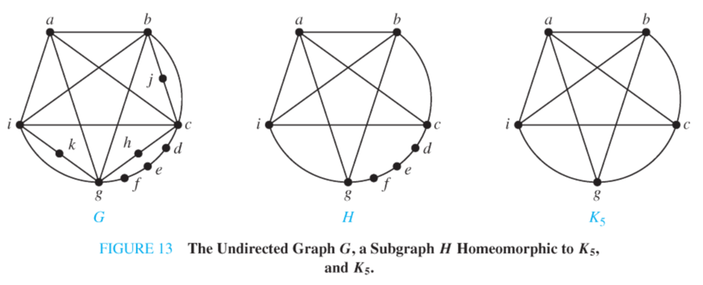
Example 8
Determine whether the graph G shown in Figure 13 is planar.

Slide 29
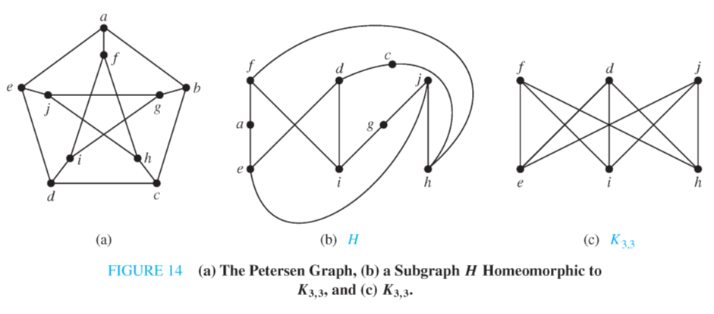
Example 9
Is the Petersen graph, shown in Figure 14(a), planar?

Slide 30
对偶图

Slide 31
完全正则图
每个节点度数相同的平面图为正则图
如果一个正则图的对偶图也是正则图，则称是完全正则图。
完全正则图的每个面的度数都相同。
完全正则图称为柏拉图体，被古代看作是宇宙和谐的象征

Slide 32
Platonic Solids– 柏拉图体
A Platonic solid has congruent regular polygons(正则多边形) as faces and has the same number of edges meeting at each corner.

Slide 33
Platonic Solids
Each one can be flattened into a planar graph:
with constant degree: k and
the same number of edges bounding each face: l

Slide 34
# of edges
coming from x
vertex x
=
Each edge belongs to 2 faces:
By Euler’s formula:
and k,l ≥ 3 for physical reasons

Slide 35

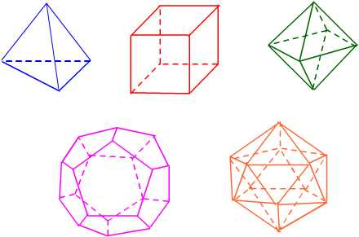
The only solutions
tetrahedron
cube
octahedron
dodecahedron
icosahedron

Slide 36
Please feel free
to ask questions!
((( )))

Slide 37
Homework
设G是连通平面图，G的每个面的度数大于等于l (l ≥ 3)，则
e ≤ l(v-2)/(l-2)
用上述性质证明K_{3,3}不是平面图。
§10.7
6, 8, 12, 18, 24, 30

